Slide 1
The right to a fair hearing in employment disputes
Lessons from research
Morag McDermont, University of Bristol Law School
Nicole Busby, University of Strathclyde Law School
Notes:
Nicole

Slide 2
About the research
Context
Cuts in legal aid funding
Many workplaces without trades unions
Few can afford lawyers
Citizens Advice as new ‘industrial relations’ legal actor
Tracking people with employment disputes
In-depth qualitative investigation: 2012-1014
Many self-represent at Employment Tribunals
Impact of ET fees introduced July 2013
Notes:
A DTI survey in
2005 found that 42% of employees had experienced a problem with their rights at works
in the last five years, and eight per cent. left their employment as a direct result of a
workplace dispute.5
In the past, the law took something of an abstentionist approach to work
by 2011 only 23% of
employees were covered by collective bargaining, and only 16% in the private sector.7

Slide 3
Lena’s story
Lena: betting shop manager for 22 yrs
Company restructuring
Lena and others under investigation for ‘credit betting’
Credit betting as ‘accepted practice’
Formal disciplinary proceedings
Manager advises to contact Acas
CCTV evidence – dismissed
“I mean you don’t know these procedures because nobody actually informs you of anything, you know like your rights, you don’t know that you could go to Acas, that at any point you could take the company to court .. there’s nothing even though there is a set of rule books [at work] which not being funny, were changed actually after my investigation and after they sacked so many people.”
Dismissed from new job after bad reference

Slide 4
Lena’s story (2)
Citizens Advice appointment
Missed 3 month deadline for submitting ET1
Advised to submit – request extension
ET1 accepted – hearing date set
Respondent challenge to time extension
Pre-hearing to determine time extension
Limited CAB resources – Lena represents herself
Complex legal technicalities
Lena did not understand purpose of pre-hearing. No preparation or witnesses to support application for time extension
Case struck out

Slide 5
Rights to a fair hearing
Art 6 European Convention of Human Rights
In determination of his civil rights and obligations .. everyone is entitled to a fair and public hearing within a reasonable time by an independent and impartial tribunal
‘Employment rights’ are ‘civil proceedings’
Human rights as “practical and effective” not “theoretical and illusionary”
(Airey v Ireland, ECtHR 1979)
EU Charter of Fundamental Rights
Principle of effectiveness

Slide 6
‘Practical and effective’ rights
Art 6 requirements
Fairness in court proceedings
Equality of arms
May require provision of legal assistance for effective participation in court proceedings
Effective remedies
Beeching Committee 1969: “the excellence of the judiciary and the thoroughness and impartiality of legal procedure are of little avail to those who cannot get their cases into court”
Equality and Human Rights Commission review 2012: .. cuts to legal aid could compromise the right to a fair trial, by limiting people’s access to legal advice and representation

Slide 7
Do workers have ‘practical and effective’ rights?
Lena’s experience as typical
Lack of awareness of rights
Chance encounters with Acas, family and friends
Limited access to TUs or advice organisations (geographically varied)
Advisors translate dispute into legal action
No legal aid – workers as ‘litigants in person’
Difficult and technical process

Slide 8
Impact of ET fees
Type A application: issue fee £160, hearing £230
Type B application: issue fee £250, hearing £850
Dramatic drop in applications
Equal pay/sex discrimination/pregnancy: 81% drop
Remission difficult, time-consuming, incl partner earnings
Shift of power towards employer – less willing to negotiate
Small claims pointless
Unison v Lord Chancellor [2014]
Insufficient evidence that particular individuals found it impossible to bring claim
Unison [2015] Court of Appeal judgment imminent
MoJ Post Implementation Review of ET fees
Notes:
Overall drop of 81% from Oct 2013Equal Pay -81% Sex Discrimination -84% Suffer a detriment/unfair dismissal - pregnancy -36% - MoJ stats these figures compare Oct 2012-June 2013 with Oct 2013-June 2014 – impact of first 9 months
Also Difficulties for advisers – ET3 provided other side of the story
Fee payment risky esp. with low enforcement of awards

Slide 9
Fairness in procedure?
Compulsory pre-claim conciliation as obstacle
Intimidating environment
Outnumbered
Problems with language
Bullying from respondent’s legal professionals - costs threats
Difficulties of representing yourself
Cross-examination by bullying employer
The human costs
Financial, health, family, future employment relations
Notes:
compulsory pre-claim conciliation. This is turning out to be another nasty obstacle for claimants – e.g. if just get number wrong, then claim is struck out – see e.g. Sterling v United Learning (EAT) and see other EAT case in my chapter where woman who alleged physical assault/sexual harassment had claim struck out for not applying to ACAS first, even though EAT accepted it would be pointless (both on EAT website). In other words, this is turning out to be a series of technical obstacles rather than about genuinely trying to conciliate claims.

Slide 10
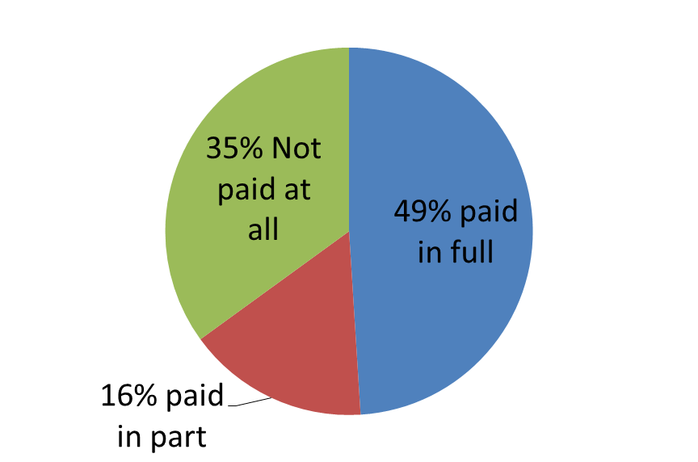
Effective remedies? Non-enforcement of awards
Non-payment of ET awards – Department for Business, Innovation and Skills (2013) Payment of Tribunal Awards
49% received full payment of award BUT 16% used enforcement action
35% of claimants received no payment
most common reason for non -payment: employer now insolvent (37%)
over half believed company now trading again under a different name/location

Slide 11
Looking to the future: fair hearings
Defending fair hearing rights in civil disputes
Adjudication system independent of workplace
Abolition of tribunal fees
Equality of arms
Role for TUs and advice agencies working together
BUT complex legal procedures require legal support
Regulatory mechanisms for simpler issues?
E.g. unpaid wages dealt with by system sim to minimum wage enforcement
Inquisitorial system of justice?
“If justice is to be administered fairly and efficiently it will have to become more inquisitorial” (Austin Mitchell)

Slide 12
Looking to the future: enforcing awards
Government should play proactive role in enforcing employment tribunal awards
Her Majesty’s Revenue and Customs has enforcement officers for the minimum wage and to collect tax debt
could be widened to cover enforcement of employment tribunal awards
Respondents could be required to make deposit with Tribunal

Slide 13
More information and comments
bristol.ac.uk/adviceagencyresearch/cab-project
morag.mcdermont@bristol.ac.uk

